Slide 1
The Evolution of the AI/ML Operations Research Professional
Major Iain J. Cruickshank, Ph.D.
SKOPE
Joint Special Operations Command

Slide 2
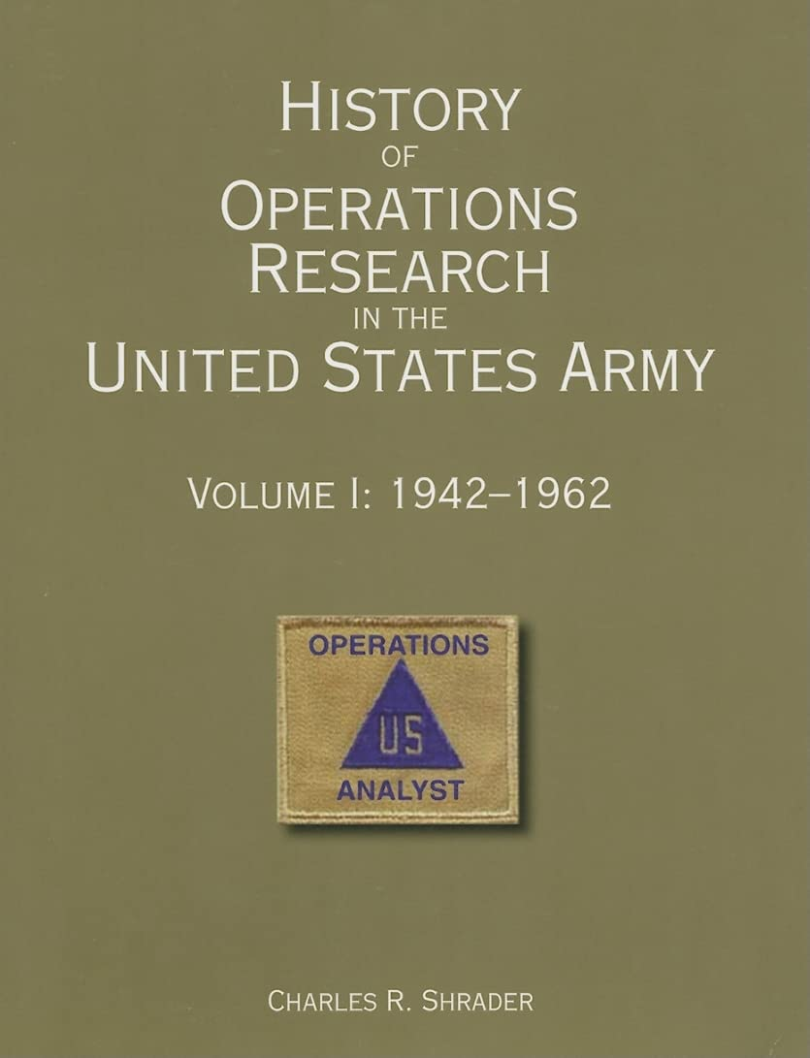
Contemporary OR in the U.S. Army
Operations Research has a rich history in the U.S. Army
  Born from the need to apply scientific rigor to military decision making
We have traditionally taken a “Big Tent” approach to OR Analysts
  Great for cross-pollination of techniques and exposure to new domains
  Challenge for distinguishing between different types of expertise
AI is changing the way we practice OR in the military

Slide 3
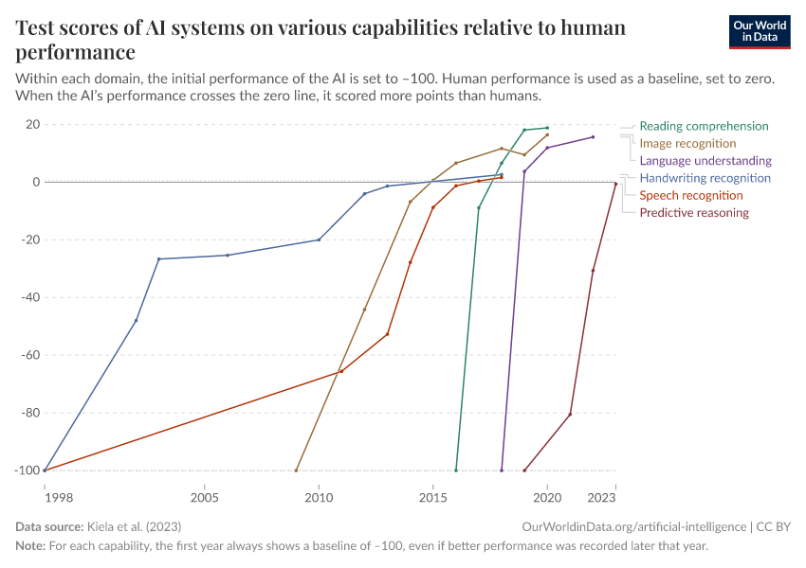
Evolution of the AI Space
AI models have consistently demonstrated increased performance on various human performance capabilities
Foundation models are widely available (and customizable) for many tasks
Generative AI provides accessible, unconstrained output
Test Scores of AI Systems on various capabilities relative to human performance. Kiela et al. (2023)
Score of AI Model relative to Human
ML models are becoming increasingly accessible and usable for many military tasks

Slide 4
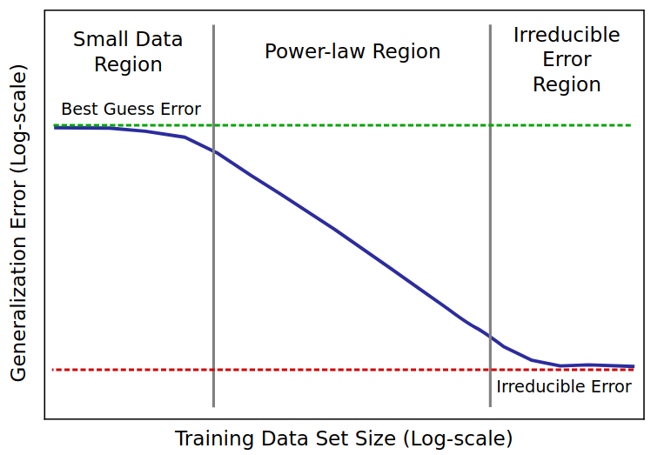
Challenges in the AI Space
Supervised models remain fragile and struggle with out-of-domain data
Generative AI has serious reliability issues and compute constraints
  Hallucination, alignment issues, bias, etc.
Scaling laws increasingly point toward the need to incorporate ML models into systems with data and people
General AI Scaling Law Pattern. EpochAI Blog (2023)
Notes:
Scaling laws, broadly construed, represent that trade off between the amount of resources (i.e., compute, dataset size, model size) and the performance of the model made with those resources. Until recently, as we have continued to scale up resources – particularly model size and compute – we have seen corresponding increases in model performance
Recently, we are seeing diminishing returns. It takes increasingly more resources to get decreasing improvements in model performance
There are also absolute limits on scaling where performance approaches irreducible error or the inherent entropy of a domain (task + data)

Slide 5
Decision Dominance and AI
The modern battlefield demands speed and precision.
  Information Advantage is becoming the new high ground
AI accelerates the decision loop
  AI can process data and information at speed and scale
Current military theory posits that the nation that controls AI will control their military destiny
Staff Analyses
Historical Data
Artificial Intelligence
Operations
ISR
PAI
Information
Information
Decision Dominance
Faster and more effective decisions relative to
Friendly Decision Cycle
Enemy Decision Cycle
Notes:
Decision Dominance involves outpacing adversaries in the decision-making process, leading to superior outcomes. It's founded on the ability to process information (Information advantage) and act decisively before the opponent can respond effectively
AI technologies can process and analyze large volumes of data far more quickly than humans, providing insights that enhance decision-making. AI doesn't replace human judgment but augments it, allowing for faster and more informed decisions.

Slide 6
Approach for Implementing Operational AI
Main Axiom:
Operational value is generated in the relationship between the user and the AI model
Leverage SOTA Open-Source models as foundations of capabilities
  Fast and cheap experimentation
Establish Command/Customer Adjacency
  Includes user training
Use a modular architecture for model hosting
  Enable multiple ways to use models
User Interface(s)
Model Serving
Databasing

Slide 7
Special Purpose AI Design Pattern
FA 49 (AI/ML Engineer)
ML Model Hosting
FA 28/ 17D (Software Engineer)
Model Hosting
FA 49 (AI/ML Engineer)
User Interface(s)
API/ Add’t Functionality
Model Retraining
Monitoring
Infrastructure Physical/Serving/Cloud
Data
Data Flows
Logging and Telemetry
FA 26/25/FA 28 (Network Engineer)
Model Creation/ Fine-tuning
Curated Data
FA 49 (Data Scientist)
FA 26 (Data Engineer)
Special-Purpose AI requires maintenance and a skilled team of technical professionals
Notes:
Special purpose model is a model that has a defined task that it is meant to perform (e.g., image classification, data embedding, etc.)
It is usually a supervised model and is meant to be highly performant at its task and work on a lot of thru put.

Slide 8
Generative AI Design Pattern
FA 28/17D (Software Engineer)
Agent Server
Agentic Prompts
Tools
FA 28/17D (Software Engineer)
FA 49 (AI/ ML Engineer)
Application Services
Model Serving
User Interface(s)
Infrastructure Physical/Serving/Cloud
FA 49 (AI/ML Engineer)
Data
Org Data
Logging and Telemetry
FA 26/25/FA 28 (Network Engineer)
Model Customizations
Curated Data
FA 49 (Data Scientist)
FA 26 (Data Engineer)
General-Purpose AI requires significant engineering and benefits from user training
Notes:
RAG solution pattern, wherein we combine a LLM/VLM with database for contextual information, has been a very useful and widely used pattern
To create a functional RAG system, especially for enterprise use, we need a number of work roles
We need software engineers to create things like serving infrastructure, user interfaces, and possibly model and application serving code (i.e., the code to process user inputs, query a served LLM, train and host a retriever model, connect to database(s)
We also need data engineers, particularly for databasing and creating data flow process for uploading data for the RAG. This work role could also include data augmentations when uploading data to the database, such as creating document summaries for addressing holisitic dataset questions.
ORSAs fit in, in a number of places and in three primary roles.
ML Engineers are needed for creating the model and application services. This overlaps with the software engineers, and this is normal and part of development. The focus of the ML Engineers is on optimizing model serving and retriever serving
Data scientists are need for customizing models through methods like prompt tuning or adapters in order to address advanced use cases, using things like curated data and logs. These data scientists could also customize retriever models.
AI Engineers could also be involved in the ML engineering tasks as previously described and in optimizations around things systems in the application service. For example, these can include prompt augmentations for user queries and retrieval modifications such as numbers of documents to bring back in response to a query. Finally, as this design pattern evolves, we will also see the need to incorporate agentic workflows. AI engineers will address this need through Agent and tool design.

Slide 9
Recent Lessons Learned with Implementing Operational AI
State of the art, open-source models can often get you a 70-80% solution immediately
  Start with hosting (open-source) models, then, maybe invest in building/ fine-tuning models
Implementing AI-solutions often requires a team of individuals with diverse skillsets; AI solutions are more than just the model itself
  Data Science, Software Engineering, Data Engineering, Platform Engineering, AI/ML engineering at a minimum
User proximity is critical for adoption and solution architecting
  No two users want to interact with models in the same way; power users want APIs and scale, junior analysts want UIs and ease-of-use

Slide 10

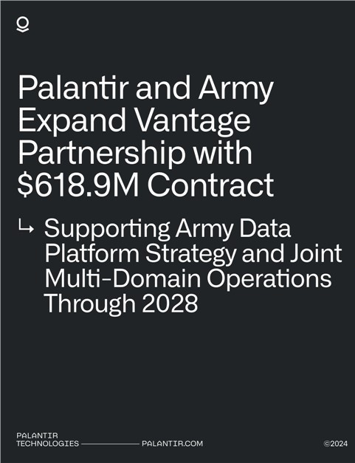

The “Last Mile” in Analytics and AI
Recent push in U.S. Military to contract for digital technology, including AI
Some axioms when it comes contracting for AI:
  There is no monolithic solution that will encompass every operational use case
  AI-enabled systems will always require maintenance
  Modularity and flexibility is more important than polished and exquisitely optimized tools
  There is a critical role for industry to play in military AI; industry can make military AI better
Service personnel are required to bridge the “last mile” of delivering military AI capability
Militaries will always need AI personnel in the ranks, no matter how much they spend on contracting for AI

Slide 11
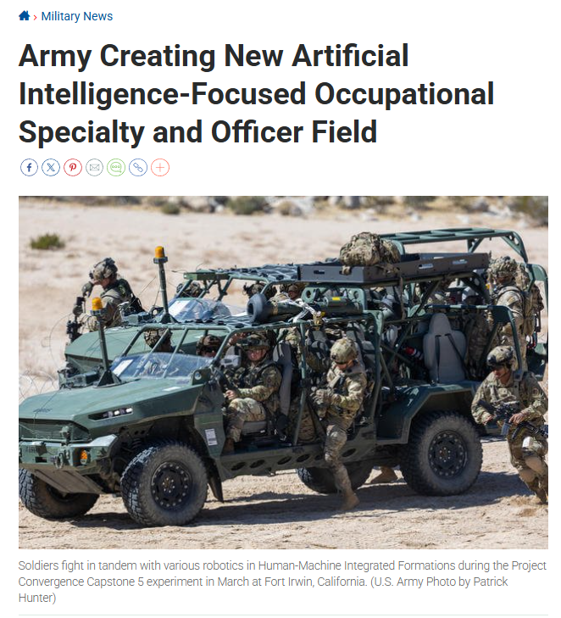
The AI/ML Officer in the U.S. Army
Adding a new Area of Concertation (AOC) to ORSA Branch (Functional Area 49)
  49B: AI/ML Officer
Also adding a warrant officer career field: 490B
Fundamental work roles of Data Scientist and AI/ML Engineer
Career paths working on “operational data teams” up to Chief Data/AI/Technology Officers for Major Commands and the Army and Joint Force

Slide 12
Implications of the AI Revolution for the Military OR Profession
There is a consistent knowledge gap in software engineering for most OR professionals when creating AI solutions
  It is usually a steep learning curve
A healthy, open-source AI ecosystem is critical to AI practitioners in the military
  There will always industry involvement in AI solutions, but we need open-source AI
  AI solution pipeline: prototype with users → contract for scale →maintain in the services
The value proposition of a Military OR professional is changing
  If a domain expert can run the kinds of analyses we used to rely on an OR professional for, why do we need that OR professional?
Notes:
Software engineering isn’t so much on the side of code, but rather understanding how to build and deploy containerized components as part of a modular system design.
Since hosting AI models is on the more complicated side of software engineering, due to the components needed to get them to work, there is a steep learning curve for ORSA

